Slide 1

Hotel Management System
The Hotel Management System (HMS) is an innovative software solution designed to automate and streamline the major operational processes of a hotel.

Slide 2
Objectives
Simplifying Daily Processes
Improving Customer Service
Reducing Manual Handling
Ensuring User-Friendly Experience

Slide 3
User Roles
Owner
Full access to all functionalities.
Manager
Access to most features with some limitations.
Receptionist
Limited access, primarily focused on reservation management.

Slide 4
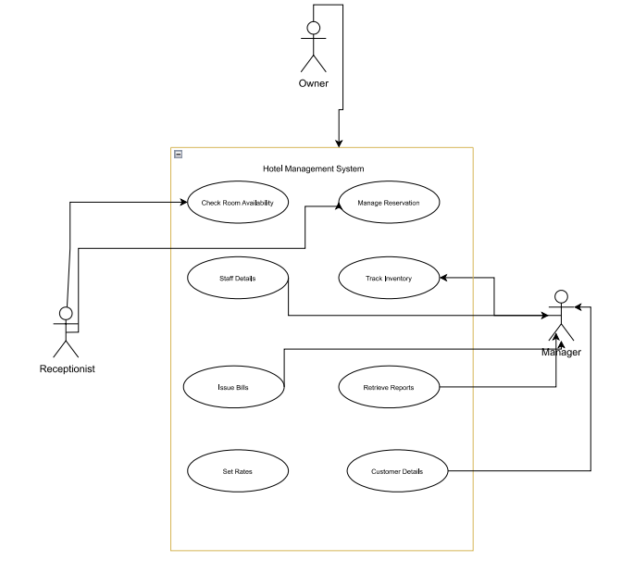

Slide 5
Product Functions
Make Reservation
Add Guest
Add Staff Members
Search Rooms
Add Payments
Issue Bill

Slide 6

Reservation System
Manages room bookings, allowing users to check availability and secure reservations effortlessly.

Slide 7
Manage
Reservations
Reservation System is for manage all room types room services.

Slide 8
Room Management System
Handles various room types and services, ensuring efficient management of accommodations.

Slide 9
Manage Room Details
Provides functionality for adding, updating, and deleting room information.

Slide 10
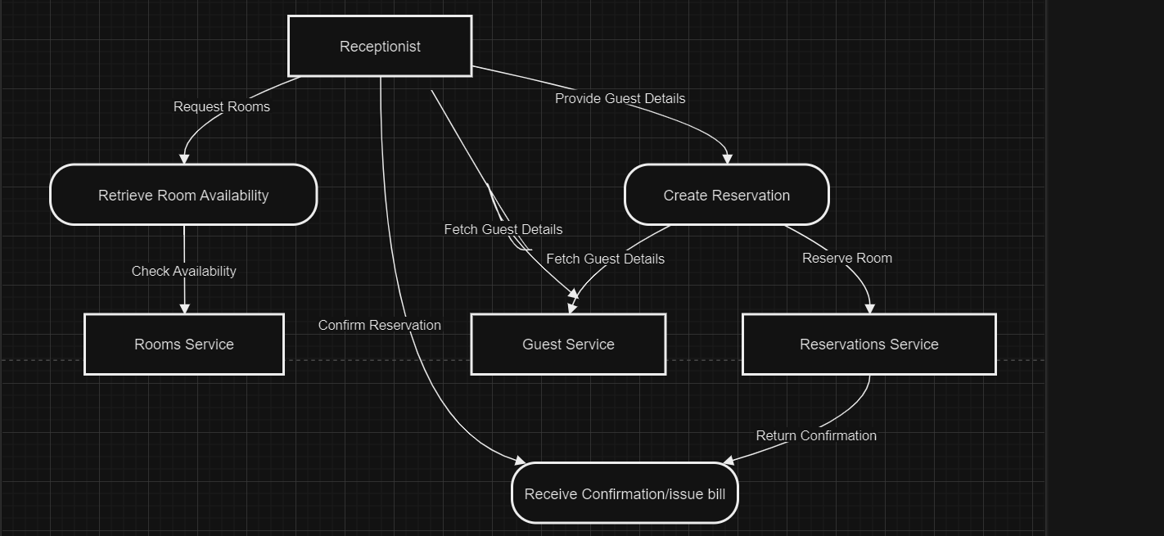

Slide 11
Guest Management
Maintains detailed records of guest information, enhancing personalized service and communication.

Slide 12
Manage Guest Information
Facilitates the addition, updating, and management of guest records.

Slide 13
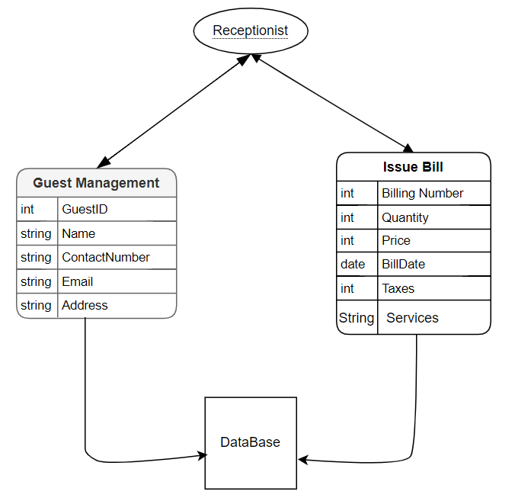

Slide 14
Inventory Control System
Keeps track of hotel inventories, ensuring supplies are managed effectively.

Slide 15
Manage Inventory
Handles inventory items, ensuring proper stock management.

Slide 16
Manage Staff Records
Allows for the addition, update, deletion, and viewing of staff profiles.

Slide 17
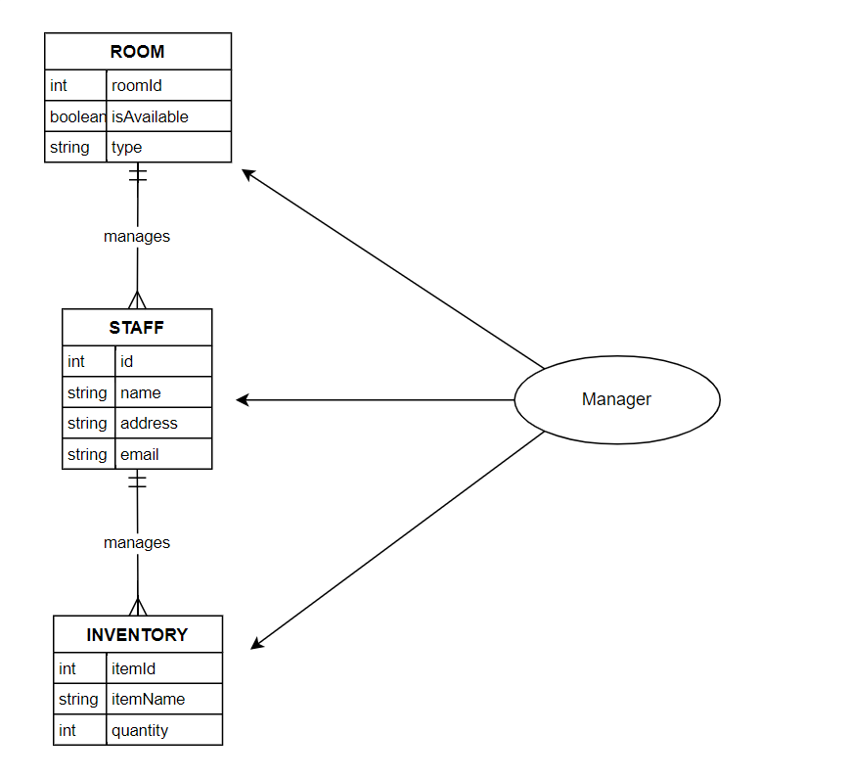

Slide 18
Administration Oversight
Provides management with the ability to monitor operations, facilitating strategic decision-making.

Slide 19
Manage and Generate Reports
Administration Service can manage and generate repots for staffs and inventory.

Slide 21
Thank You

